Slide 1
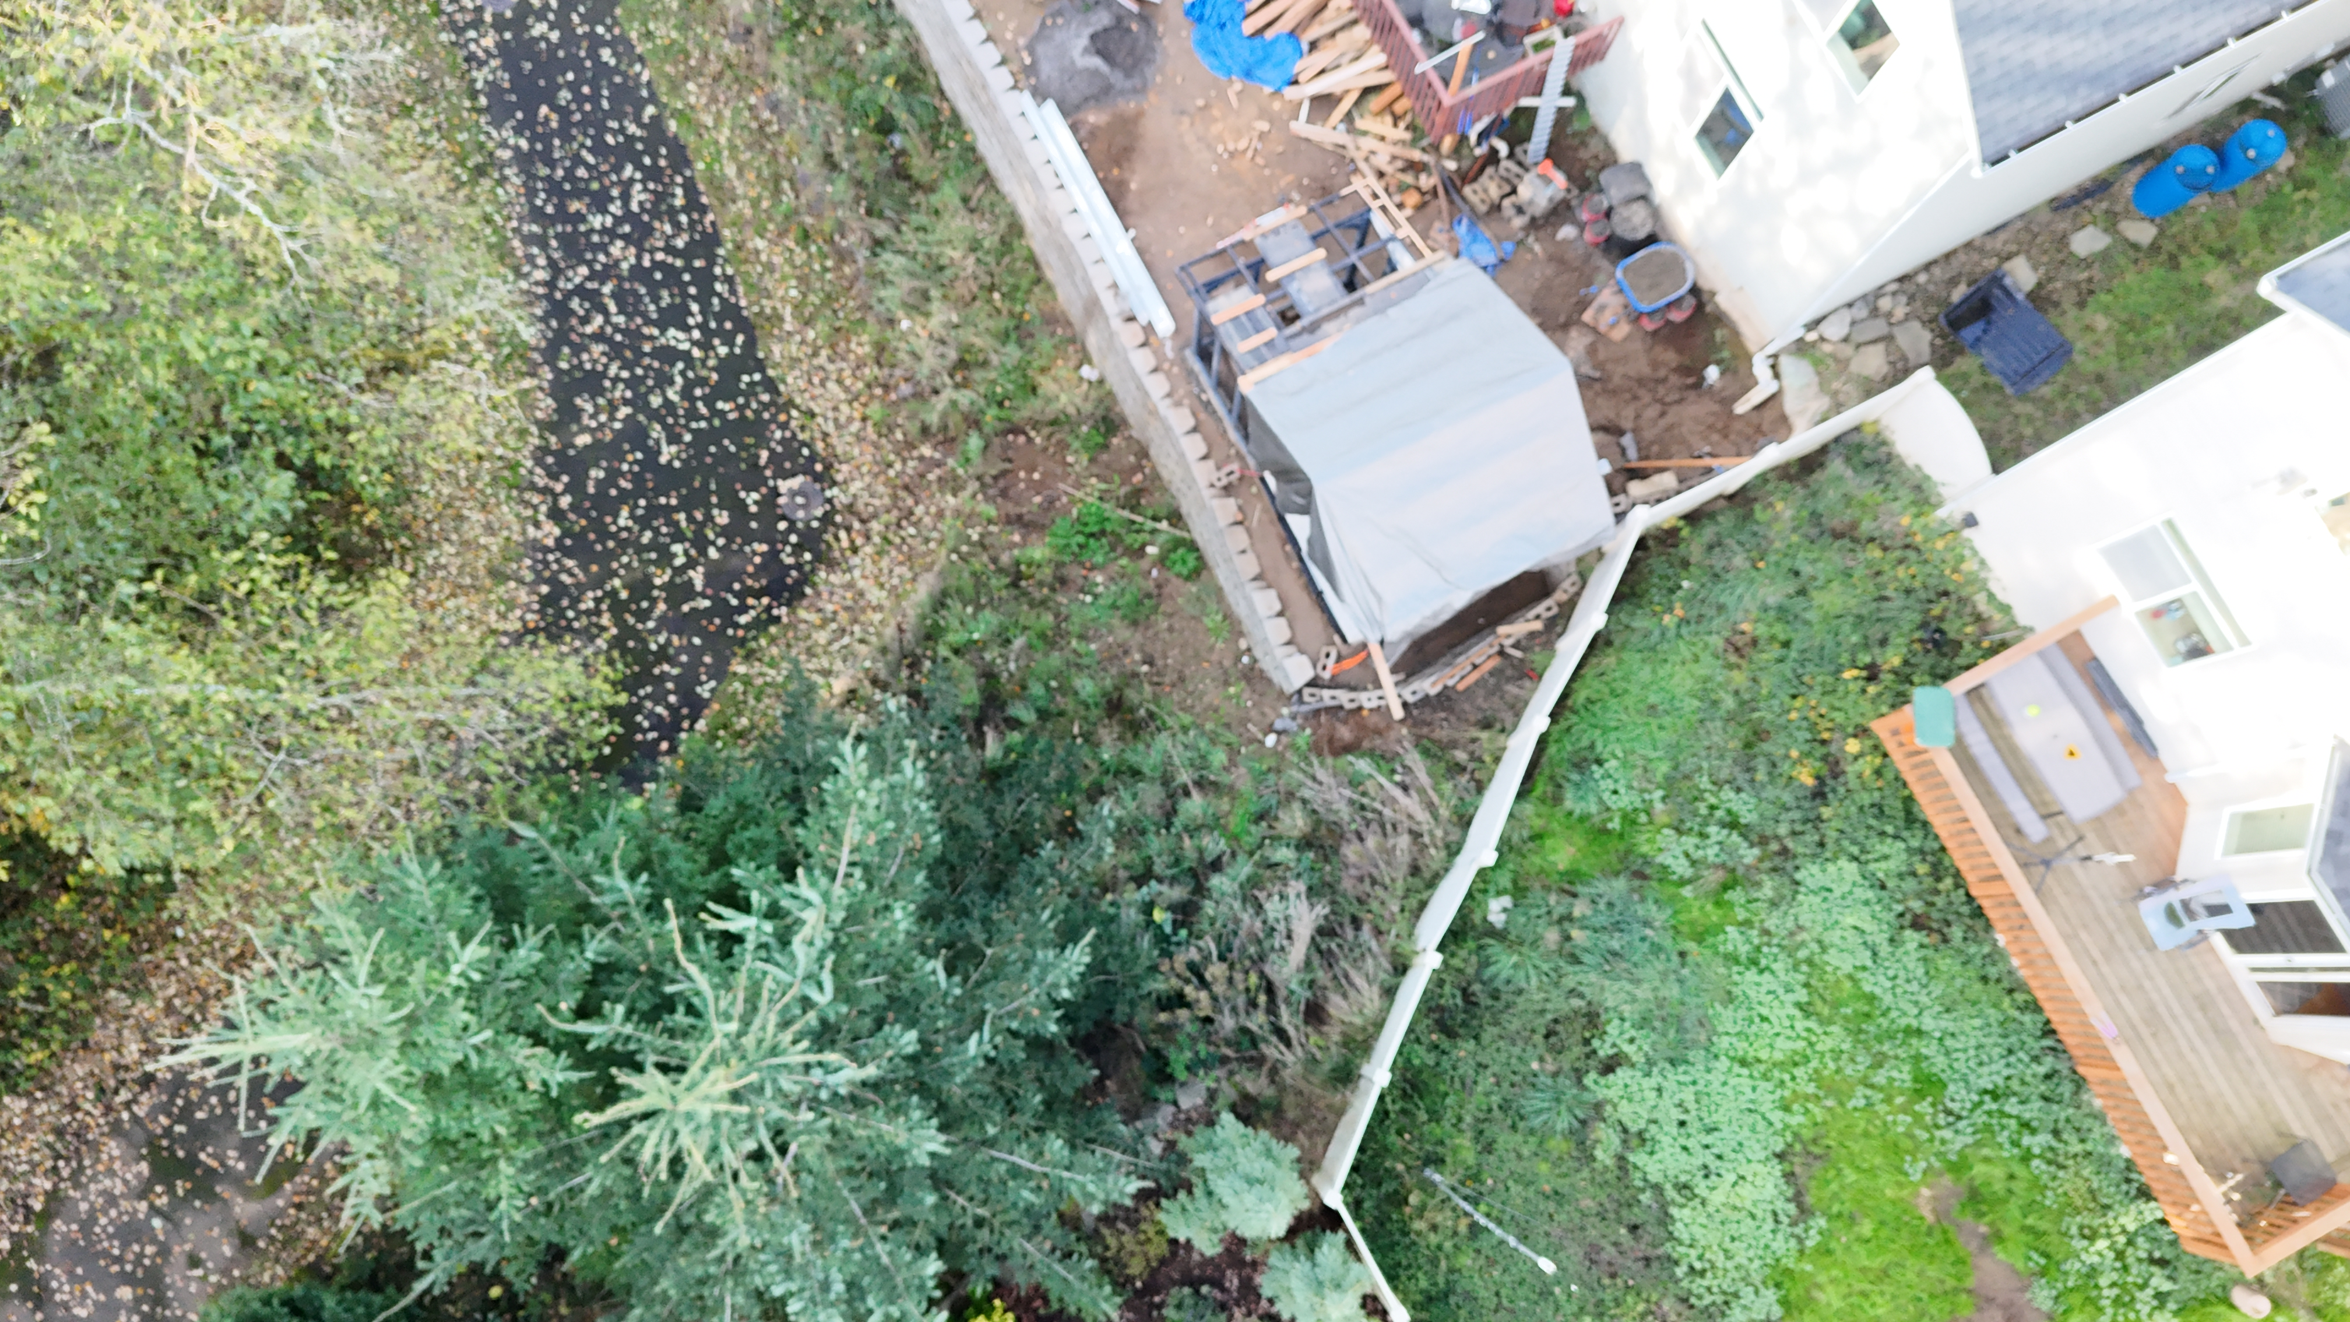

Slide 2
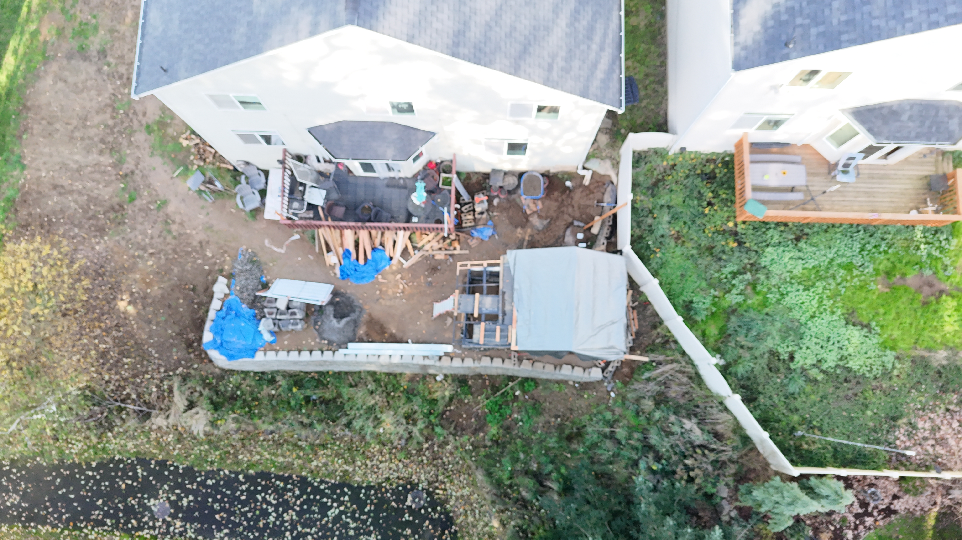
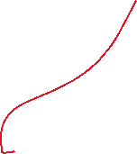
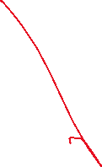
Where water is going
Run Off and Puddles
Erosion
Wall not straight or is it bulging out?

Slide 3
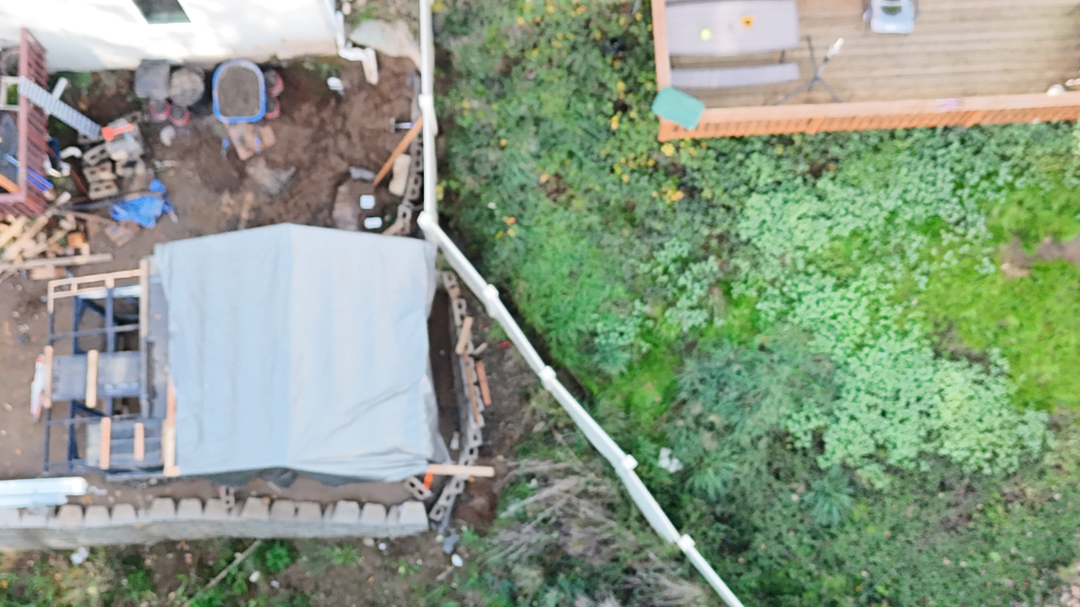
Removing earth from neighboring property, building dangerous wall in slide prone area.
Property Line

Slide 4
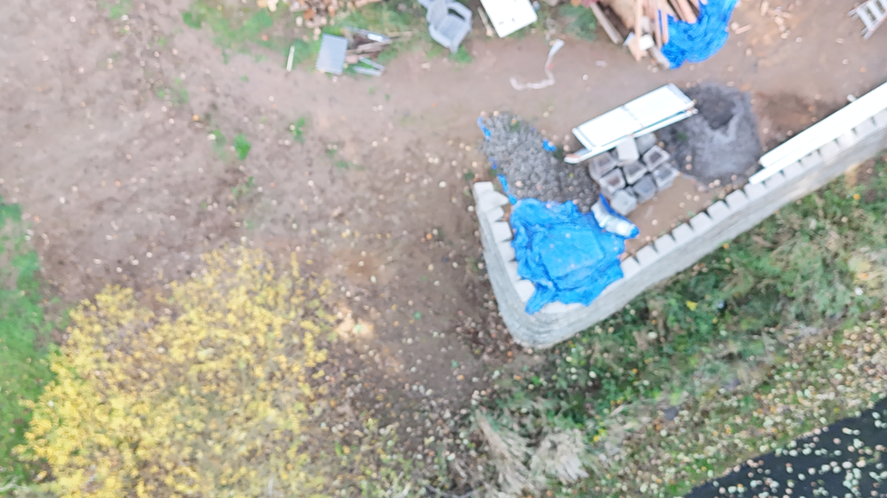
Erosion starting on City Property into green space.
West slope erosion into green area . City owns the land between the 2 houses.

Slide 5
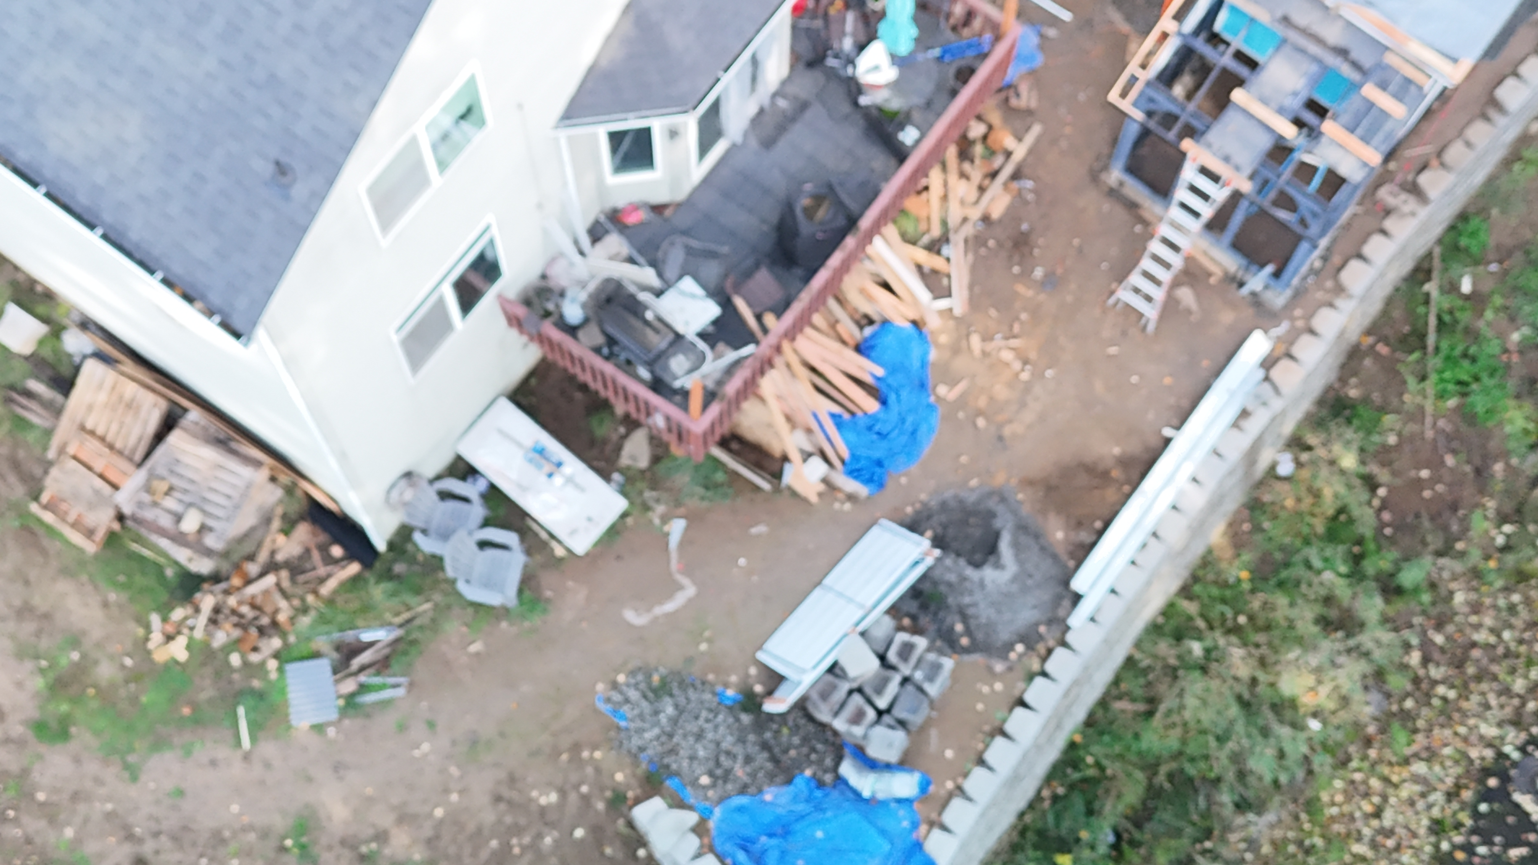
Uneven or Shifting Wall
Classic surcharge, Thousands of pounds of weight on an uneven bulging wall.

Slide 6
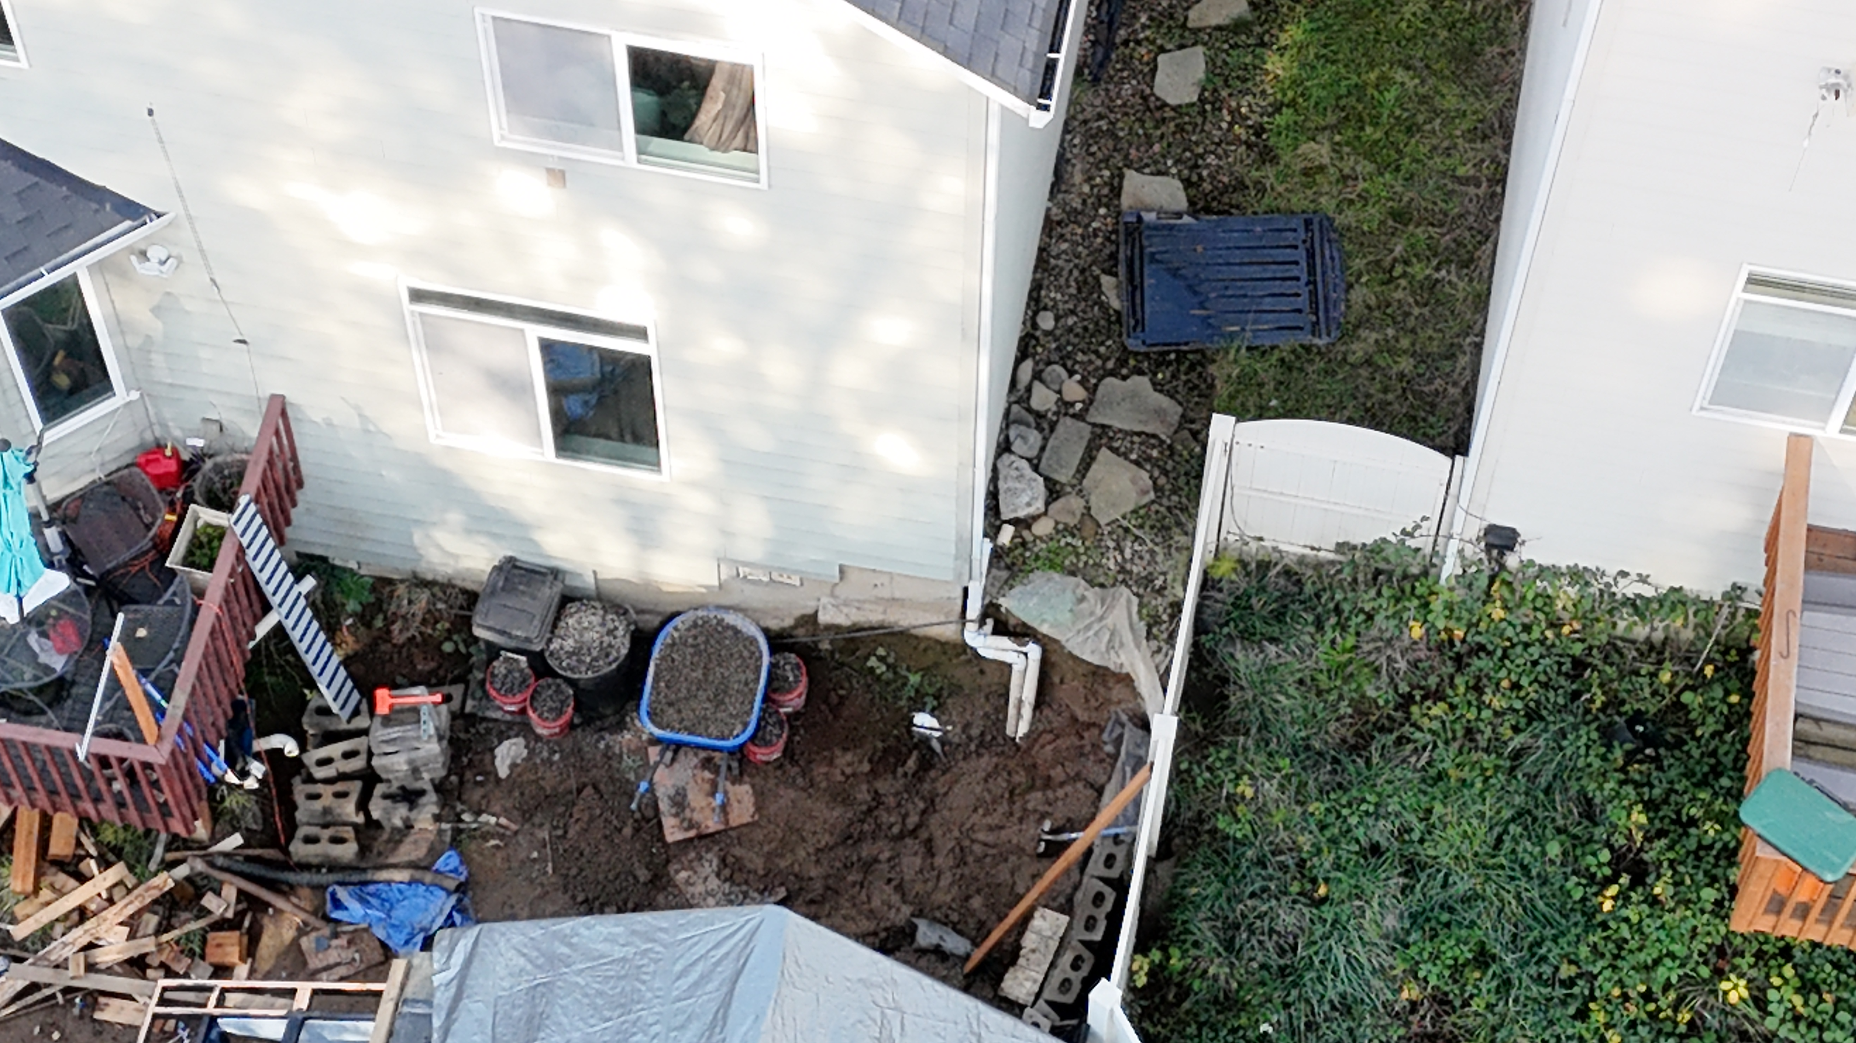
Water pooling near house, storm drain altered

Slide 7
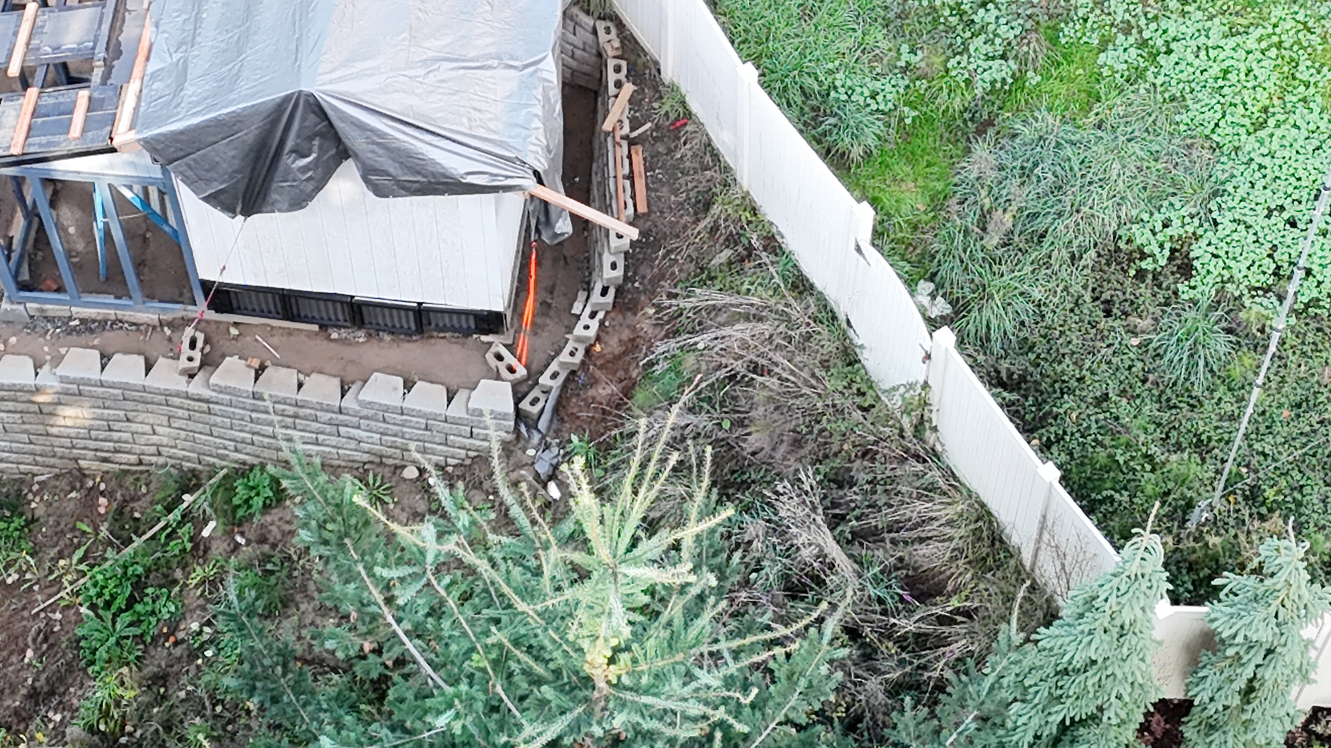
Holding back 10’s of thousands of lbs of my yard with 8lbs bricks, ON MY PROPERTY

Slide 8
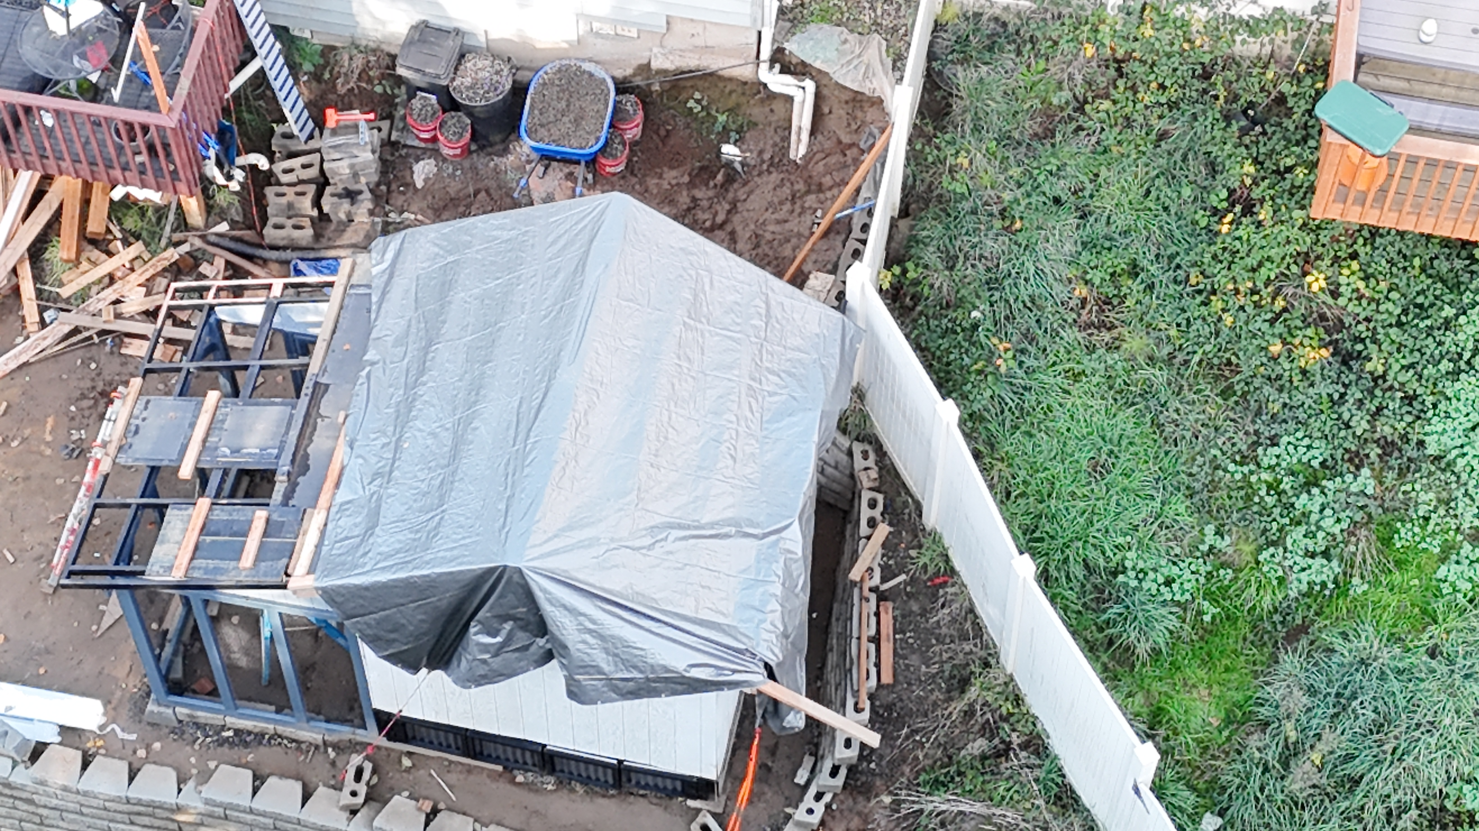
Property line. Tresspass, Damage caused.

Slide 9
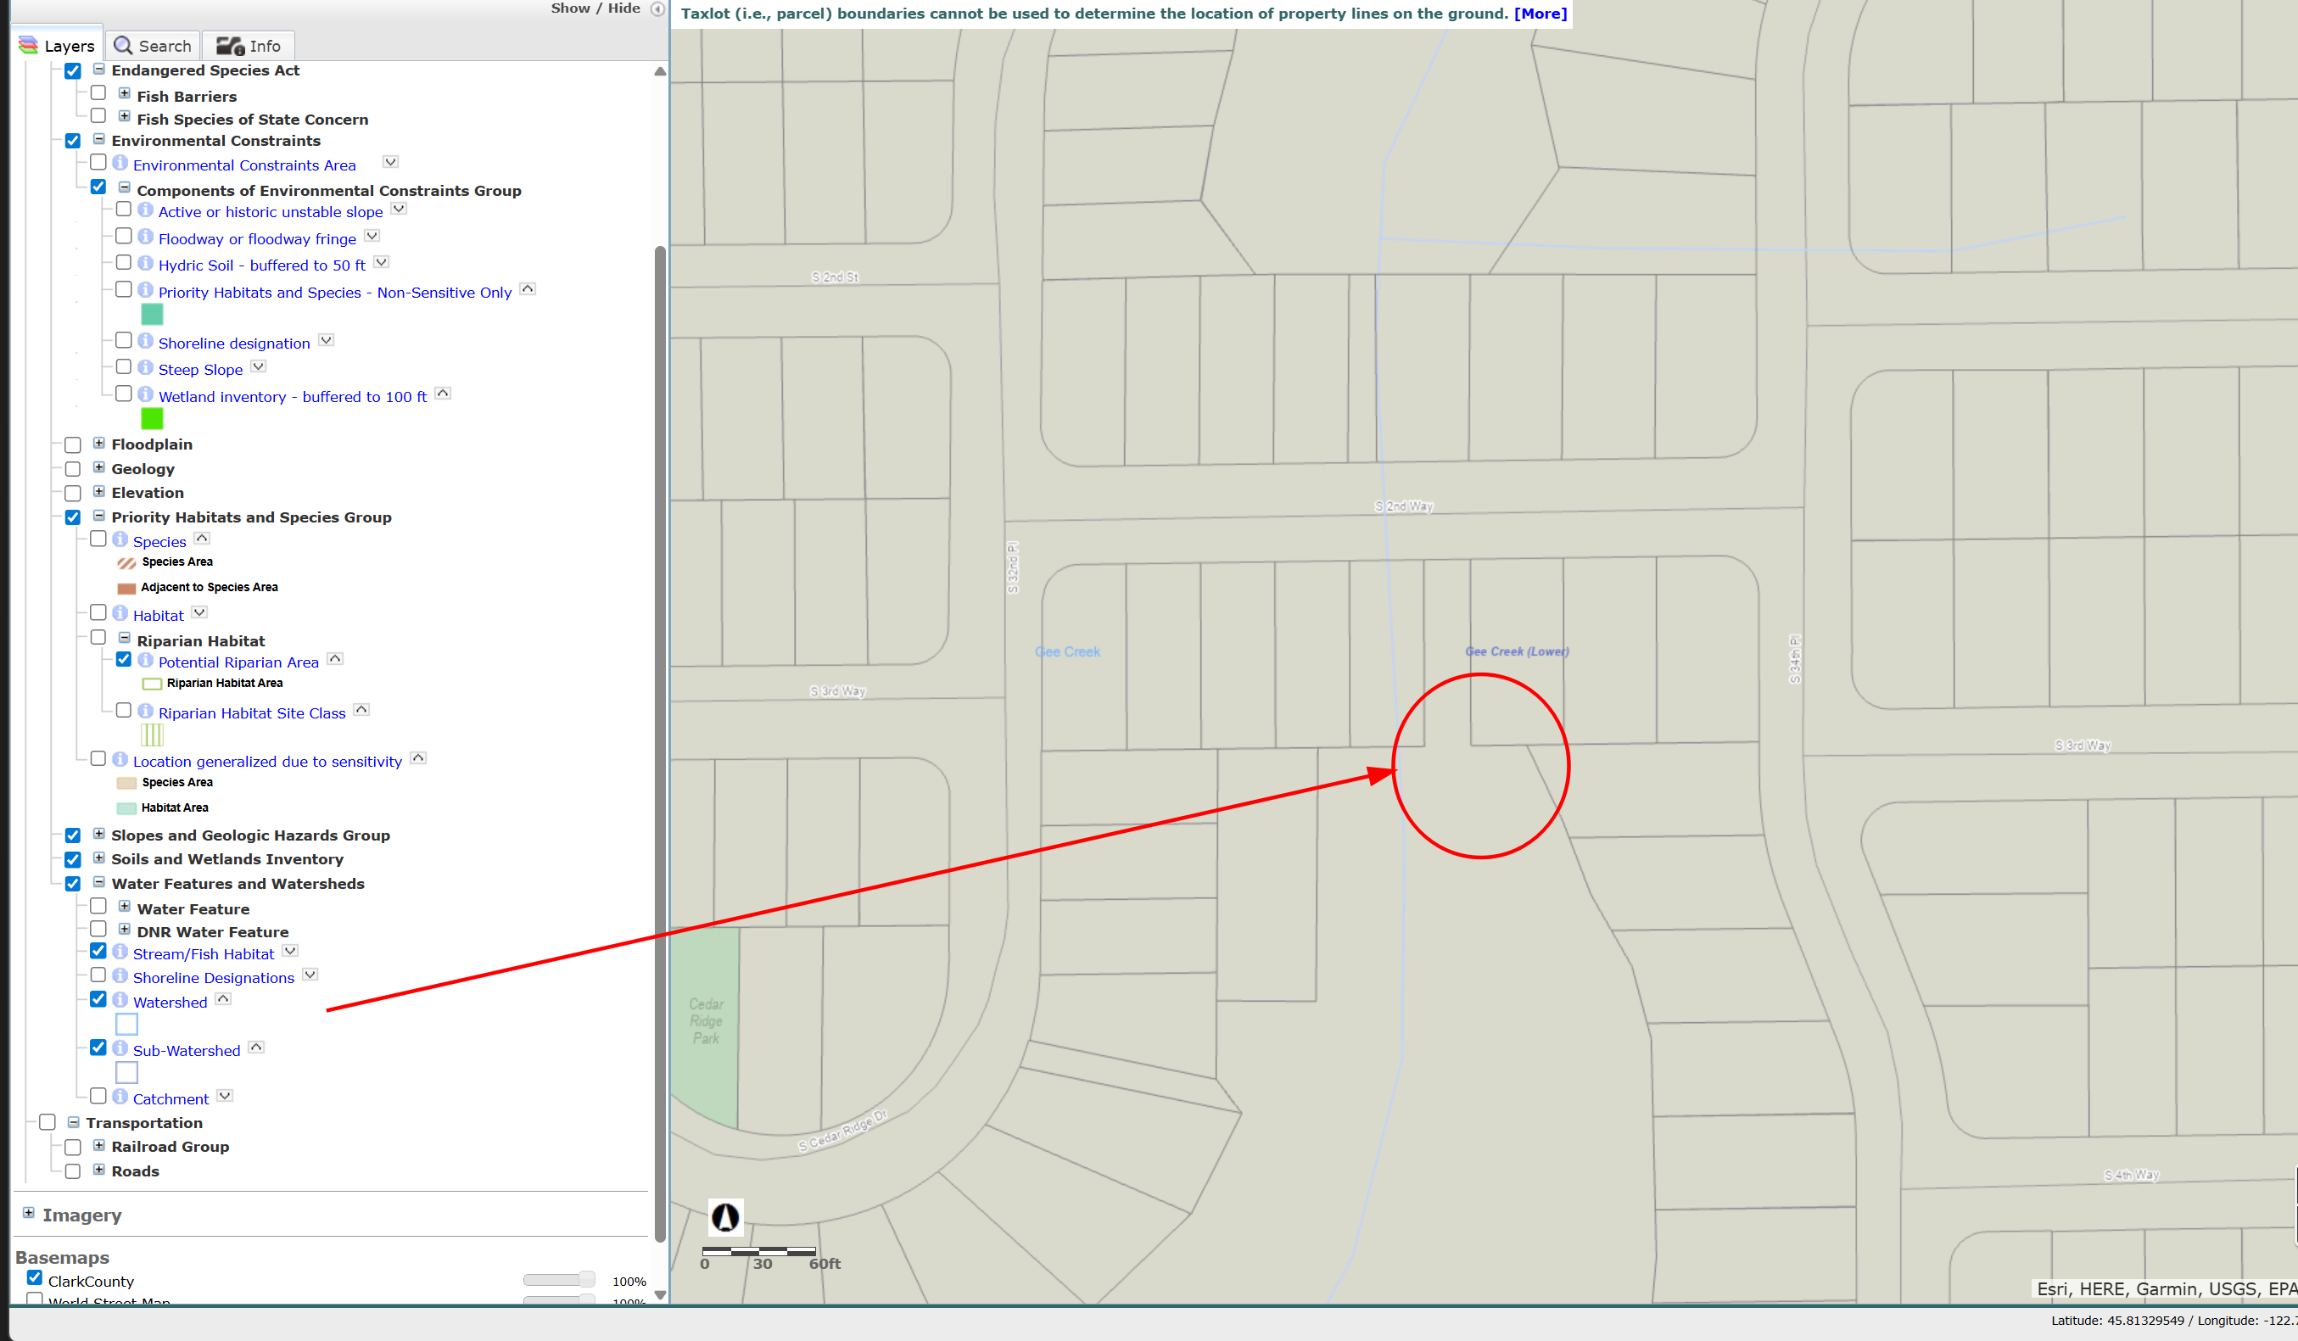

Slide 10
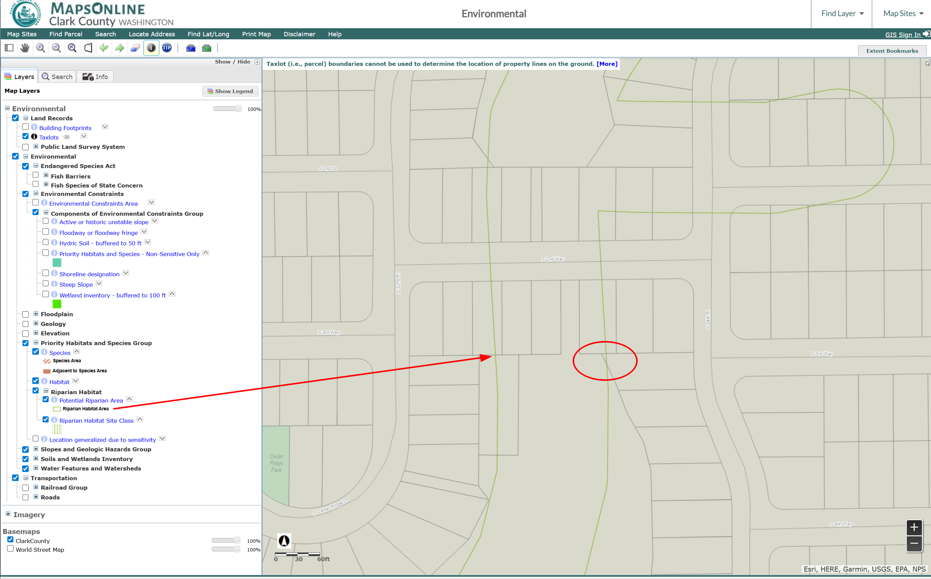

Slide 11
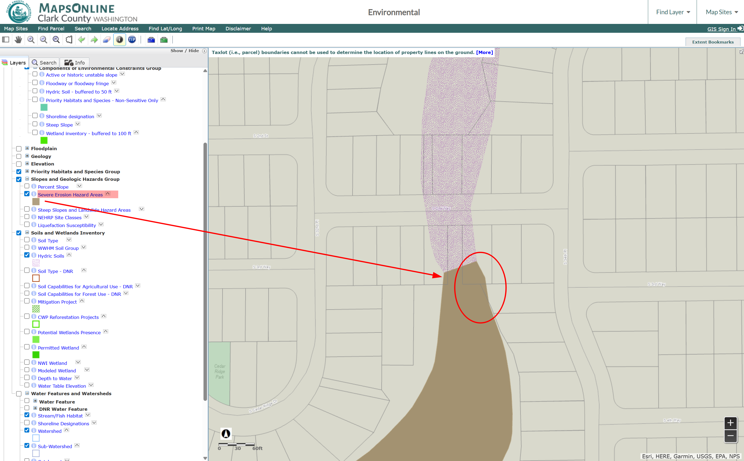

Slide 13
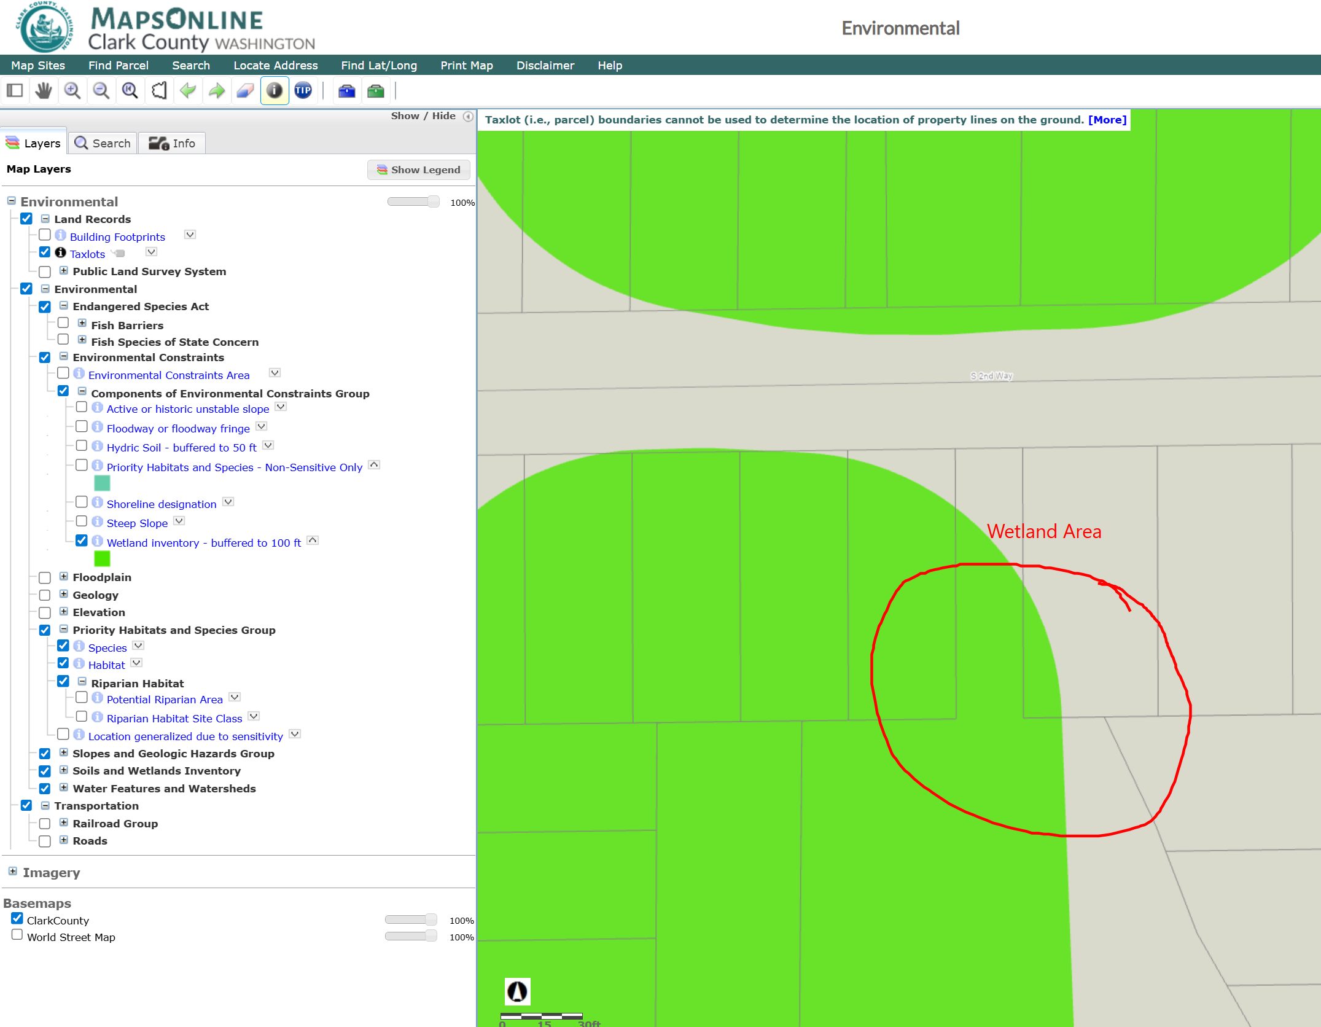

Slide 14
Sub-watershed

Slide 15
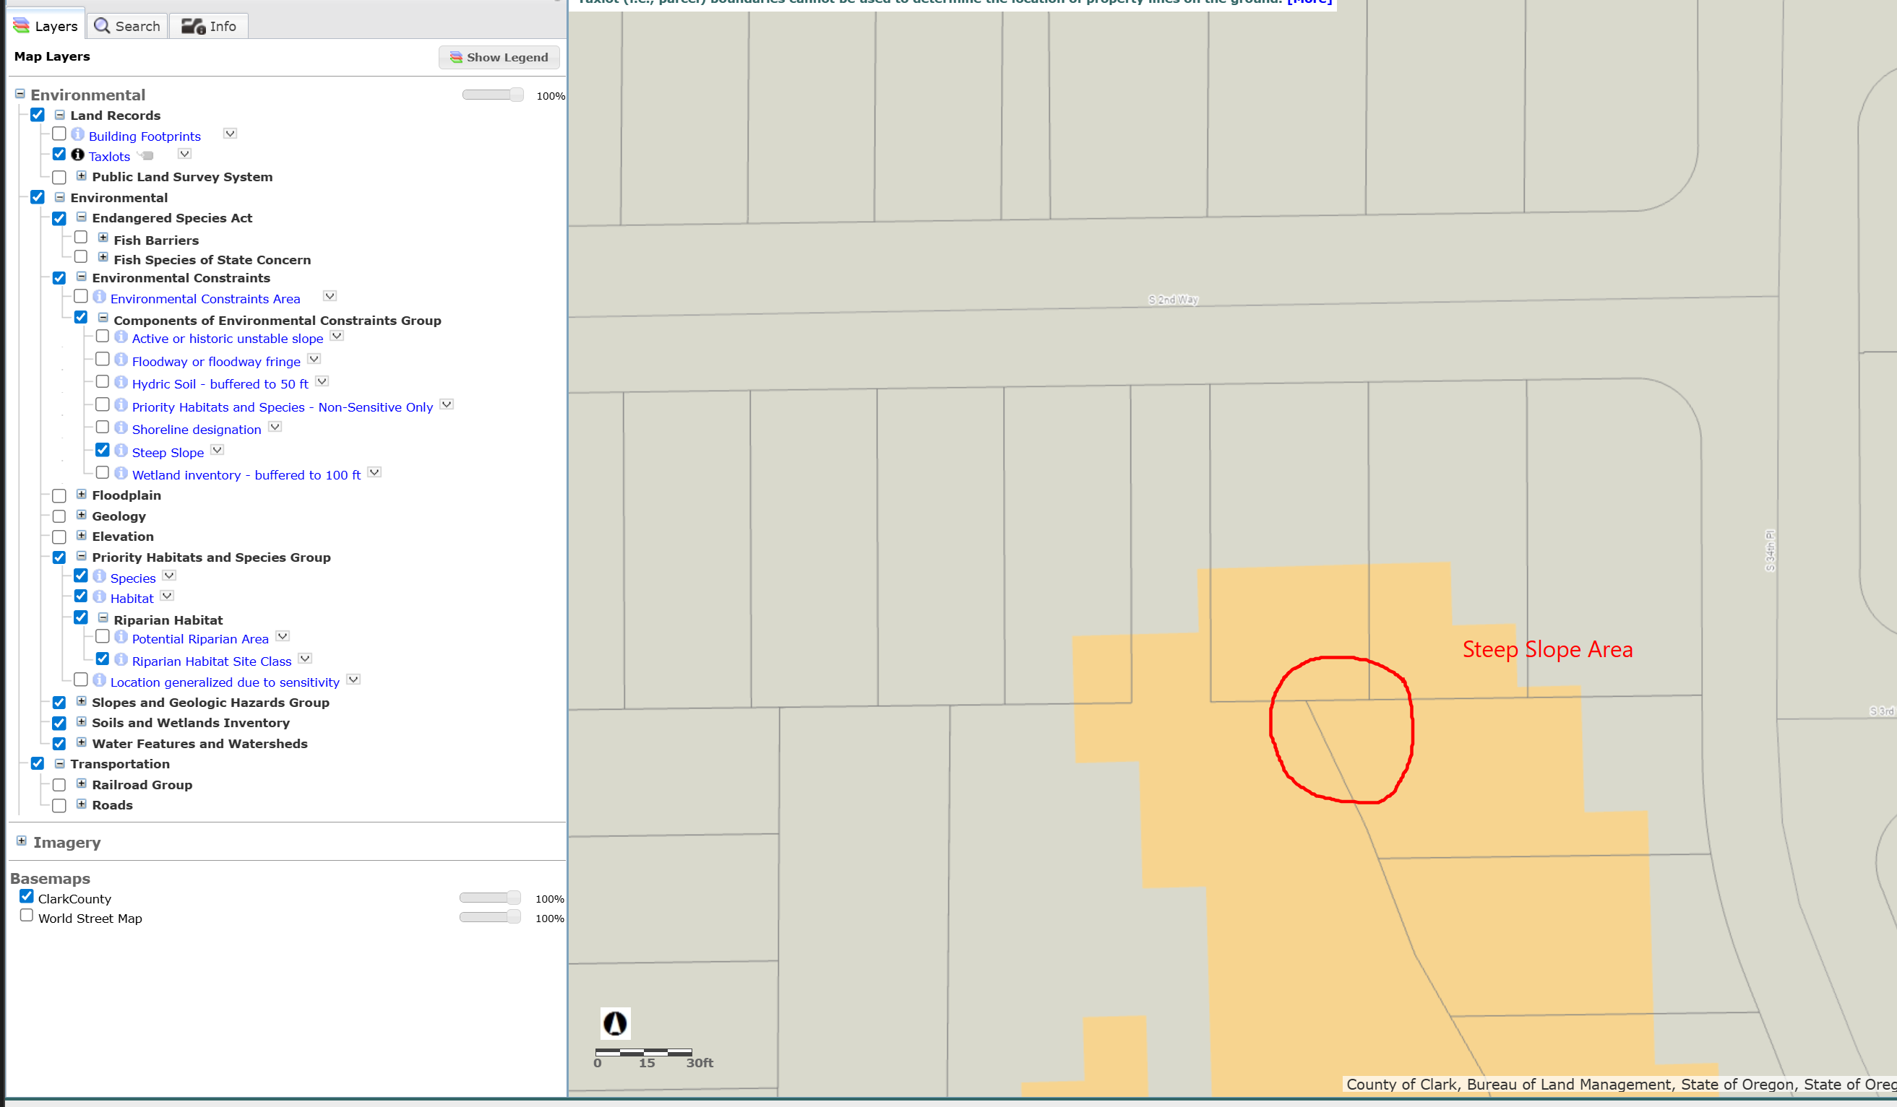
Sttep Slope, Slide Danger Area

